Slide 1
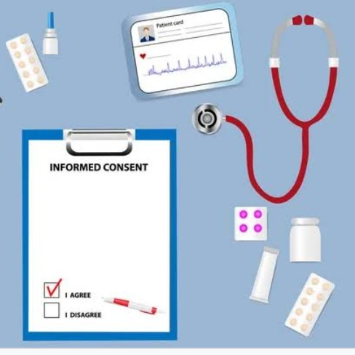
Informed Consent Waiver
Presented By :-
Manasi
Dr.Geetu
Adil
Aarti

Slide 2
Content
Introduction
Criteria for waiver of consent
Scenarios for possible Waiver
Follow up consent
Example for a request for waiver of IC
Conclusion
References

Slide 3
Introduction
Informed consent:- A process by which a subject voluntarily confirms his or her willingness to participate in a particular trial, after having been informed of all aspects of the trial that are relevant to the subject’s decision to participate
Informed consent Waiver:- It is a process in which informed consent is not obtained from subjects, or that eliminates or alters some (or all) of the elements of informed consent as set forth in Federal regulations (45 CFR 46.116d)

Slide 4
Criteria for waiver of consent (1/5)
The IRB must ensure that the following 4 criteria are met prior to approving a waiver or alteration of consent.
The research poses no more than minimal risk to subjects
The research does not adversely affect the rights and welfare
The research not practicable without the waiver
Whenever appropriate. The subject will be provided with pertinent information after participation

Slide 5
Criteria for waiver of consent (2/5)
The research poses no more than minimal risk to subjects :-
Describe specifically how the proposed research poses no more than minimal risk to subjects.
Minimal risk – means the probability and magnitude of harm or discomfort anticipated in the research are not greater in and of themselves than those ordinarily encountered in daily life or during the performance of routine physical or psychological examinations or tests

Slide 6
Criteria for waiver of consent(3/5)
2. The research does not adversely affect the rights and welfare :-
Describe why the waiver will not adversely affect subjects
Consider the following :
Are tests / procedures being done solely for this research or is data being collected on past procedures that are completed?
Could the results of research potentially affect the subjects regular care?
Would use of their information affect subjects regular care
Could participation in the study negatively affect the subjects wellbeing

Slide 7
Criteria for waiver Of consent (4/5)
3. The research not practicable without the waiver :-
Describe why it would not be feasible to conduct the study without a waiver or alteration of informed consent
Consider the following :
It is likely that the data being reviewed contain out of data contact information for subjects?
Does the number of charts being reviewed make it impractical to contact each subjects for consent?
Would identifying and contacting each subject to obtain consent be prohibitive

Slide 8
Criteria for waiver Of consent (5/5)
3.Whenever appropriate. The subject will be provided with pertinent information after participation :-
Describe whether information resulting from the study will be disclosed to subjects.
Consider the following :
Will the results from the study have any effect on subjects or their regular care?
Are there any anticipated benefits that would change care subjects have already received?

Slide 9
Scenarios for possible Waivers
The FDA only permits an IRB to approve a clinical investigation without participants informed consent in the following circumstances :-
Emergency Use
Exception from informed consent for planned emergency research
Informed consent for in vitro diagnostic device studies using leftover human specimens that are not individually identifiable

Slide 10
Follow-up consent(1/2)
In occasional minimal risk studies, the EC may waive consent when subjects initially cannot consent for themselves, but require consent for later procedures when subjects recover their capacity to consent
Example where follow up consent required :-
The EC approved waiver of consent for a minimal risk blood draw from patients arriving unconscious at the emergency room
But if the researcher want any procedures to continue after subjects become competent to consent or want the subject to participate in follow up procedures

Slide 11
Follow up consent (2/2)
Contents of follow up consent
The consent form should clearly describe
What procedures occurred without the subjects consent
Why they were performed
What additionally will be done if consent is given to continue the subject in the study

Slide 12
Example for a request for waiver OF IC (1/5)
The researcher plans to determine whether some specific blood chemistry values change in individuals undergoing clinically indicated abdominal surgery and if there is a correlation of changes with the increased incidence of complications after surgery.
The proposed research plan is to:
Review the medical records of all individuals who have undergone abdominal surgery in the past 2 years.

Slide 13
Example for a request for waiver of IC (2/5)
Data to be collected :-
Diagnosis before surgery
Type of abdominal surgery
Specific pre-surgery blood chemistry values
Specific post-surgery blood chemistry values
Description of the problems after surgery
Age range of the individuals.

Slide 14
Example for a request for waiver of IC (3/5)
From a preliminary estimate, there are about 5,000 abdominal surgeries per year at the hospital.
The researcher will double code the data so that only the researcher knows the link in the unlikely event the data must be verified for accuracy.
The results of the research will not affect the clinical care of the individuals because the information will not be examined until after subjects leave the hospital.

Slide 15
Example for a request for waiver of IC (4/5)
Sufficient justification for IRB to approve a waiver of informed consent :-
The research involves minimal risk, as the review of subjects medical records is for limited information
The information is not sensitive in nature, and the data are derived from clinically indicated procedures

Slide 16
Example for a request for waiver of IC(5/5)
There is an extremely low probability of harm to subjects status employment, or insurability
The precaution taken to limit the record review to specified data and double coding of the data further minimize the major risk, which is breach of confidentiality
Contacting subjects to obtain their consent could be considered an invasion of privacy and cause subjects undue anxiety

Slide 17
Conclusion
Informed consent may be waived in following :-
Minimal Risk
Medical records research
Observational research on large groups
Research on tissue/blood samples
Research in the Emergency setting
Potential subjects are not competent to give consent at the time of intervention
No opportunity to obtain surrogate consent

Slide 18
References
ICH-GCP E(6) R(2)
https://irb.ucsf.edu/waiving-informed-consent

Slide 19
Thank you!

